Slide 1
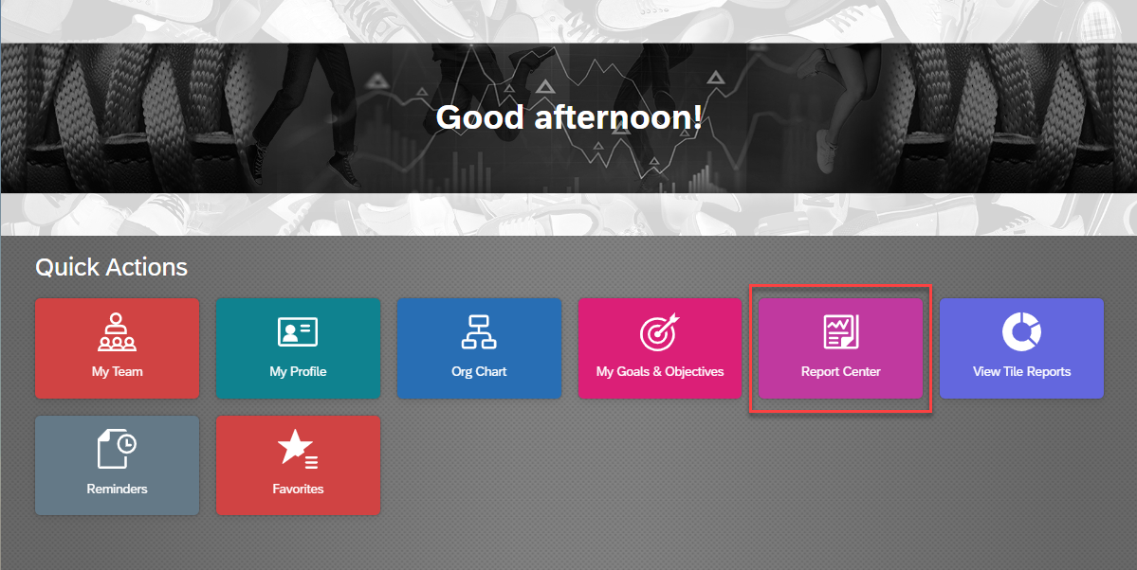
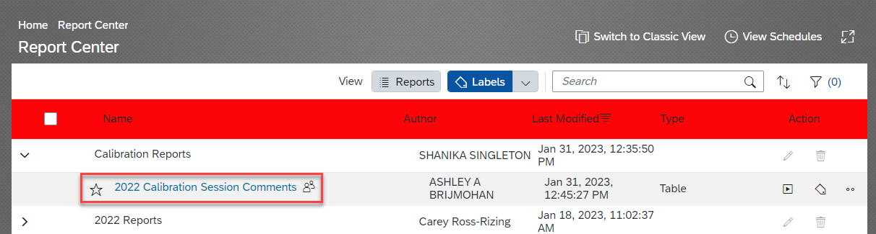
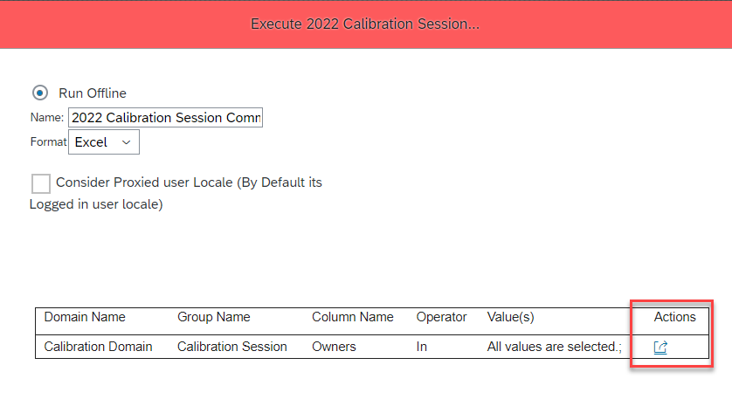
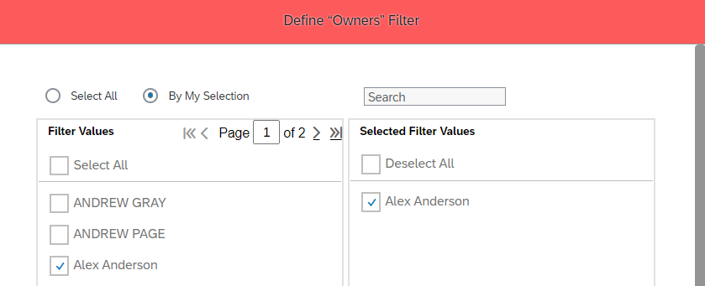
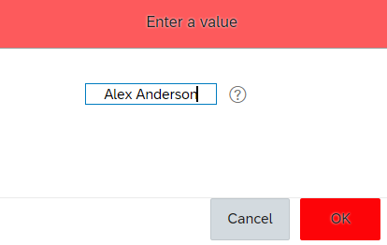
SuccessFactors: 2022 Calibration Reports
2022 Calibration Session Comments Report
This report will display the all the Calibration Comments generated during a session for a specified leader.
Expand the Calibration Reports label, and click on the report: 2022 Calibration Session Comments
Click on Action Icon and select whether you want to filter by editing or free-text.
Edit – allows user to select from a menu of Owners/Leaders.
Free-text – allows user to type out an Owners/Leader’s name.
Example of selecting “Edit” to choose owner value.
Example of selecting “Free-Text” to input owner value.

